Slide 1
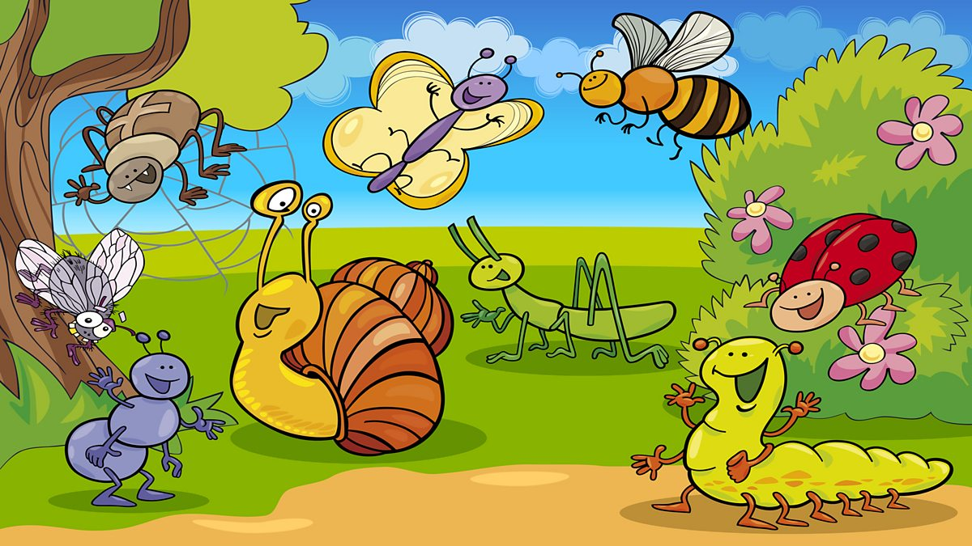
Communication/Language and Literacy
Listening, Attention and Understanding
I will understand/follow simple instructions, questions and commands.
Speaking
I will know and retell the story ‘The Very Hungry Caterpillar’.
I will know and use vocabulary linked to the theme ‘Magnificent Minibeasts’ including wild, pet, habitat, wildlife.
Comprehension
I will know how to turn the pages of a book carefully.
I will read and re-read a selection of books to engage in conversations about the story, develop understanding and learn new vocabulary.
Word Reading
I will know the SSPS pictures for e, u, r, h, b, f. j, v, w, x, y, z
Writing
I will write the initial sound in my name.
Nursery Summer 1
What will I be learning this half term?
Reminders
As the weather gets warmer, please ensure your child brings a named water bottle to school each day to keep hydrated.
On sunny days, please ensure that you have applied suncream on your child before they come to school. Your child can then bring their suncream to school in a named container to re-apply during the day.
Please make sure that all clothing and sun hats etc are named so that we know whose is whose!
Personal, Social & Emotional
Self-Regulation
I will show confidence in visiting the local church.
Managing Self
I will know how to calm myself by stopping and taking deep breaths.
I will know to brush my teeth to be healthy.
Building Relationships
I will consider the feelings of others in stories.
Magnificent Minibeasts
Physical
Gross Motor
I will know how to skip, hop and stand on one leg.
Fine Motor
I will know how to use a comfortable grip when holding a pencil.
Understanding the World
I will find out about the Kings coronation and how Queen Elizabeth was on the throne before him.
I will learn from visitors of various occupations e.g. a plumber, farmer, vet.
I will know that a butterfly comes from an egg.
I will know how to respect and care for living things.
I will investigate light, dark and shadows. .
I will listen to a selection of bible stories.
I will know how to know how to play interactive games on the iPad/IWB.
Maths
Number
I will count in correspondence to 10.
I will subitise to 3.
Numerical Patterns
I will use language including on light, heavy, full and empty.
I will make shape pictures using different resources.
I will solve real world mathematical problems with numbers up to 5.
Expressive Arts & Design
I will know the nursery rhymes/songs;
5 Little Men in a Flying Saucer
Jack and Jill
Miss Polly Had a Dolly
I will explore painting on a range of different surfaces such as tin foil, cling film, sugar paper etc.
I will have a go at observational drawings.

